Slide 1


Developing a bot for Telegram messenger
‘Halyk_bot’

Slide 2

Briefly about team:
Sophomore students at Suleyman Demirel University :
Auyeskhan Nazarbek (CEO)
Rakhimzhanov Zhanbolat (Head of PR Department)
Artykbayev Kamalkhan (Technical Support Engineer)
Dossymbayev Dias (Head of HR department)
Rzayev Aybek (Financial Director)

Slide 3
Main aim of the project:
Improving the communication service of the bank with the client by developing the bot for Telegram.
Gaining great experience by creating something new in one day.
Creating an evolutionary method of service for clients.

Slide 4
Why we decided to work on this project?
Telegram — is the free messenger for smartphones on iOS or Android, tablets and desktop. We developed this bot on Telegram because it is the only the most popular messenger with open source API. Using this bot, clients will be able to receive necessary information for only a few seconds.
Also Telegram uses a symmetric encryption scheme called MTProto. The protocol was developed by Nikolai Durov and other developers at Telegram and is based on 256-bit symmetric AES encryption, RSA 2048 encryption and Diffie–Hellman key exchange.

Slide 5
Tasks:
Analyzing needs of clients
Search for materials about creating a bot in Python
Making a plan of features, functions and structures
Step by step developing using pytelebotapi
Final testing of our bot
Launch

Slide 6
The main functionalities of the prototype of the bot
The main idea of the bot is the quick help to the client. So we added such features as:
List of offices/ATMs
Search of the nearest office / ATM
Actual currency rates
Obtaining information on services of bank (deposits, credits, payment cards, mobile banking, etc.)
Receiving news, actions and different types of services
Obtaining information on vacancies and submission of CV
Making a compliant through the application

Slide 7
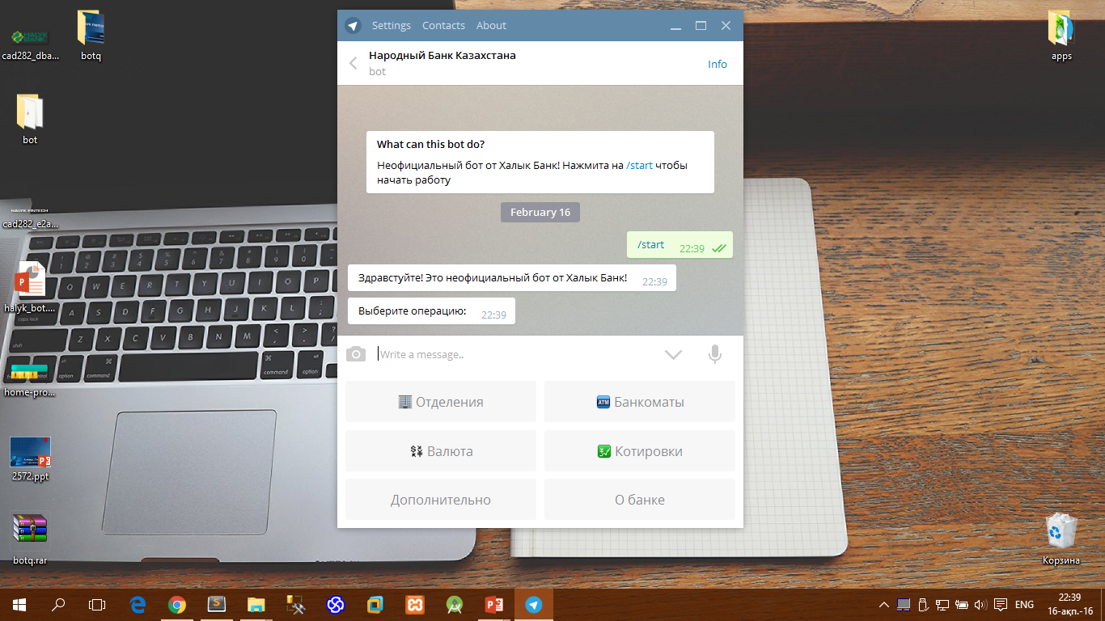
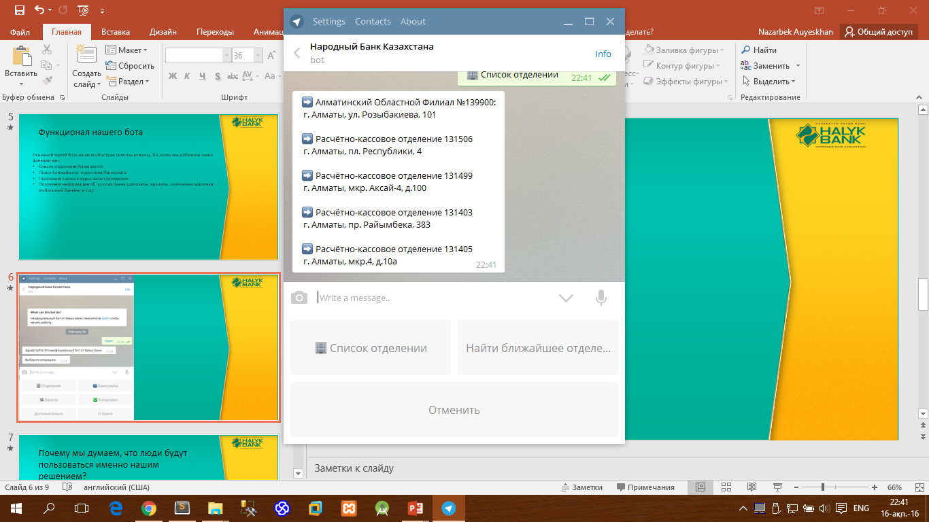

Slide 8
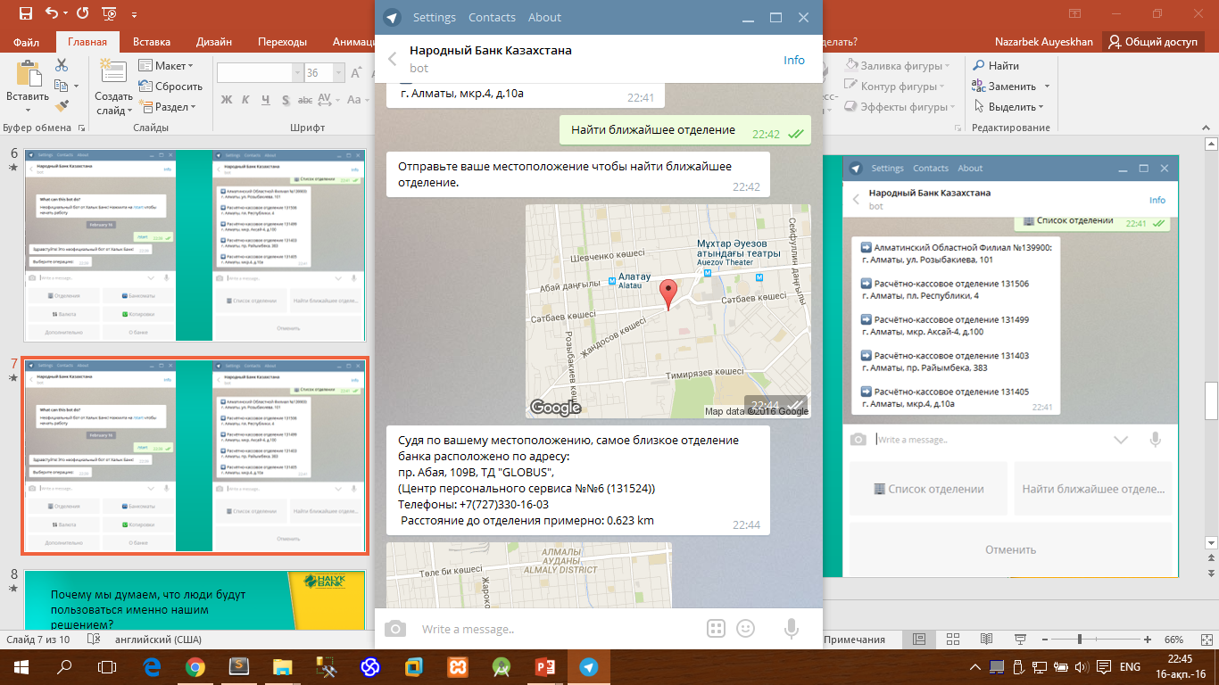
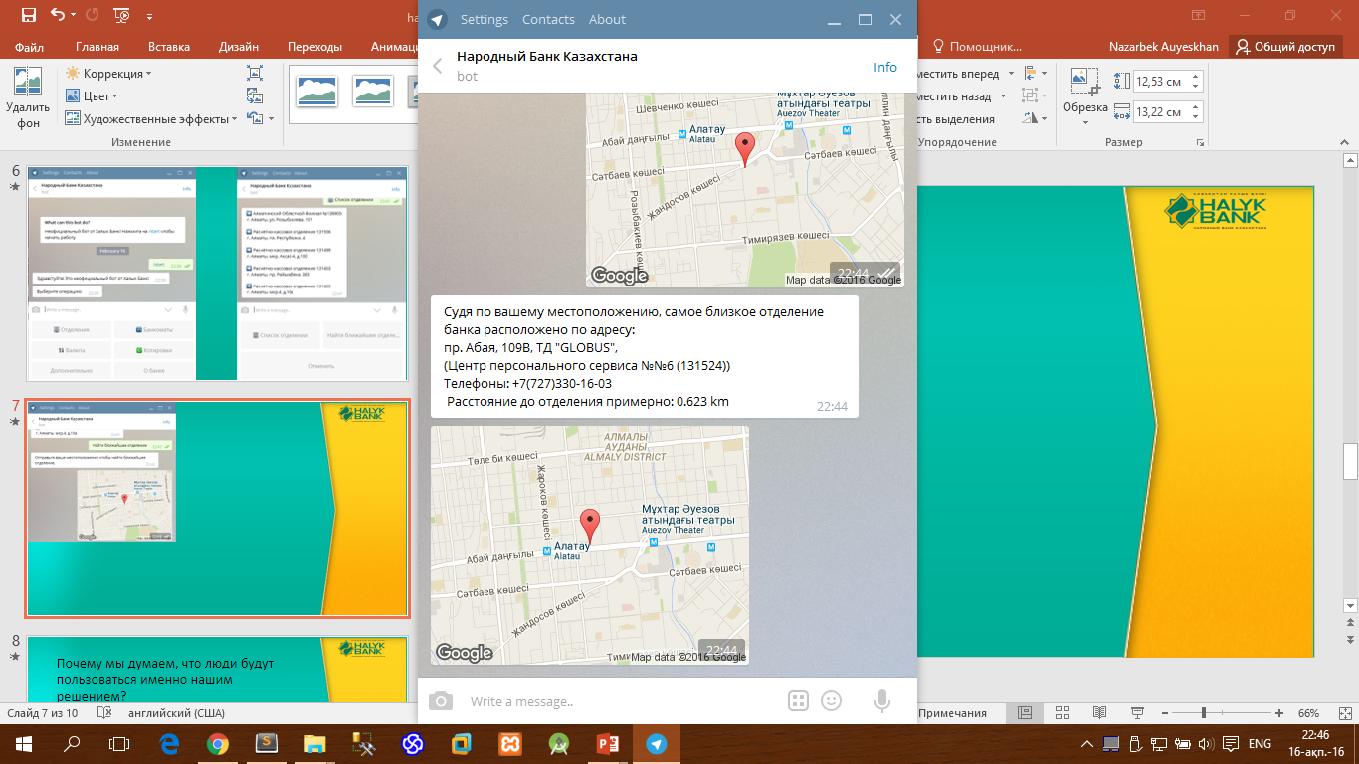

Slide 9
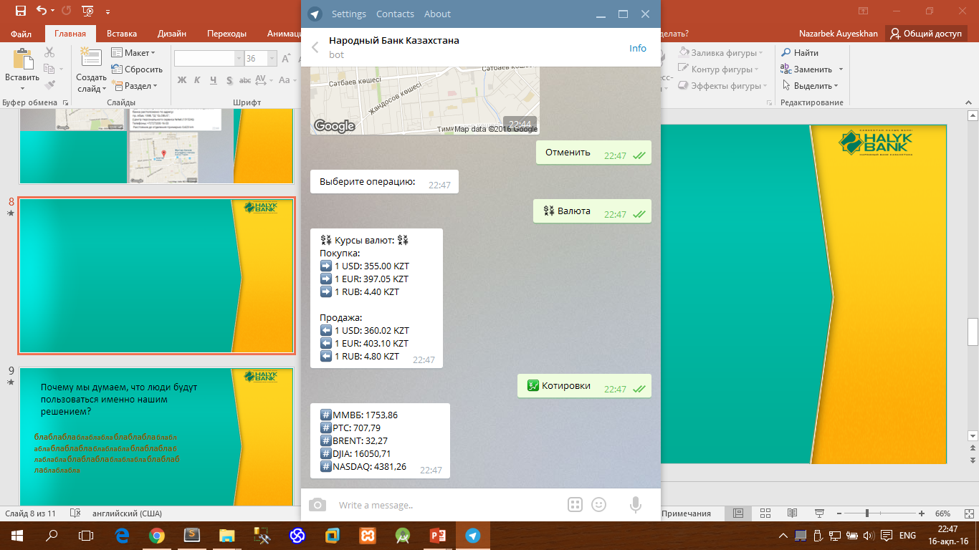
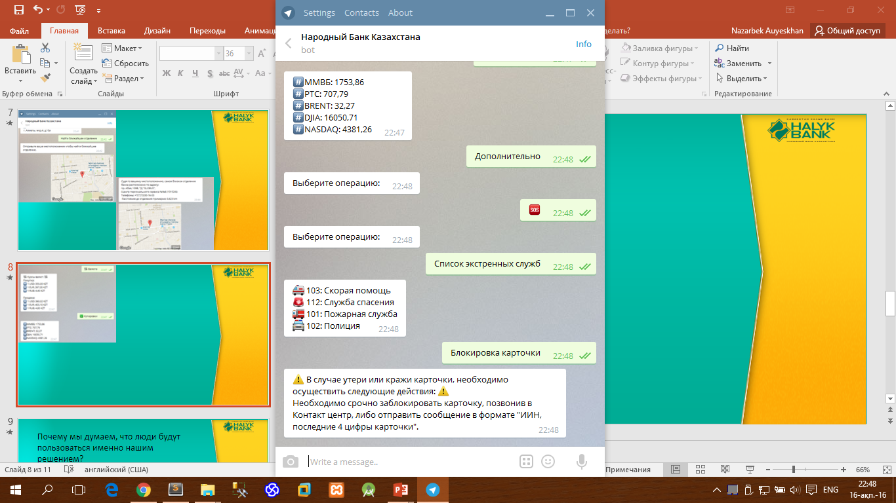

Slide 10
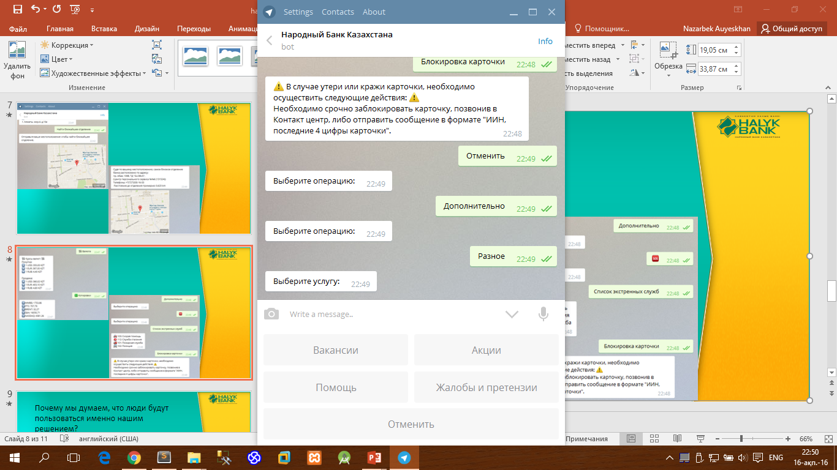
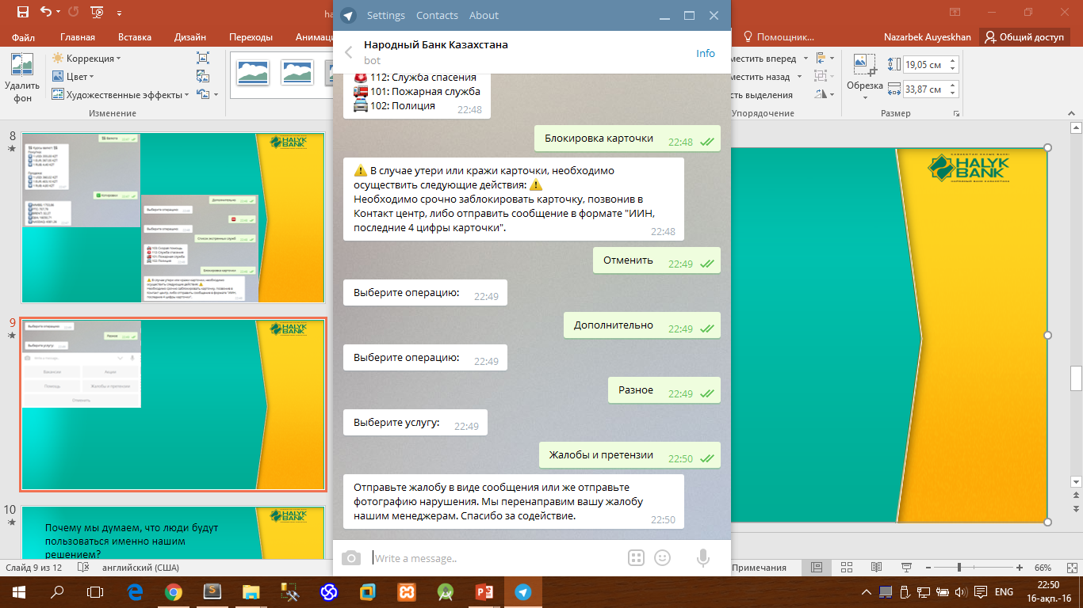

Slide 11
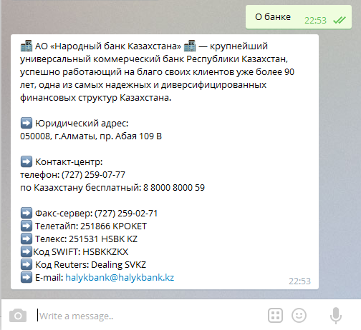

Slide 12
What features will have our bot in case of giving the API by Halyk Bank?
Credit calculator
Monitoring of ATMs
Electronic query system
Fast payments
Money transfer
Mailing, analytics
Replacement of SMS Banking

Slide 13
Why the think that the clients would use our product?
First of all, Bank should be comprehensive.
Also, by creating
Secondly, by creating of such convenient services as – "Fast payments", we can create favorable conditions for growth of client base, at the minimum expenses. Our solution has no big requirements. Also it will be possible, to embed "Fast Payments" in the MyHalyk application, without using registration.

Slide 14
That’s all we have managed in 24 hours.
☺
Thanks for your attention!

